Slide 1

Case Study Cooperative and Autonomous Systems – WS25/26
Prof. Dr. Igor Doric
Presented by:
Nitin Medisetti, nitin.medisetti@stud.th-deg.de
Saikumar Konankanchi, saikumar.konakanchi@stud.th-deg.de

Slide 2
AGENDA
Introduction
Motivation
Expected Outcomes
Sensors and Actuators
Wiring Scheme
Conclusion

Slide 3
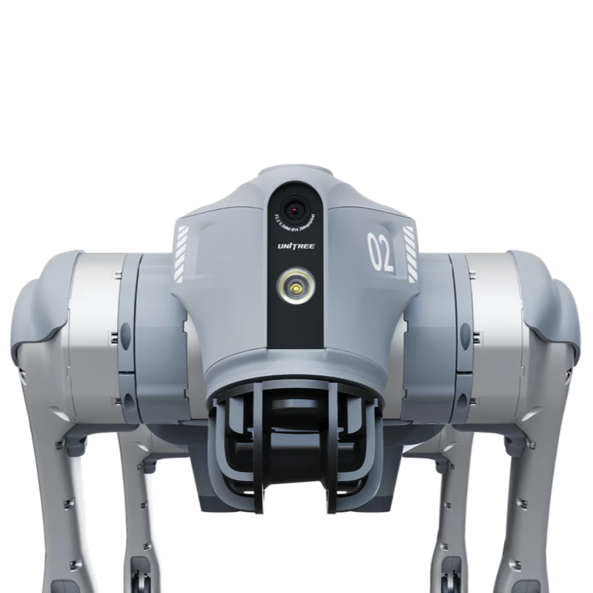
INTRODUCTION
Source: https://shop.unitree.com/en-de/products/unitree-go2

Slide 4
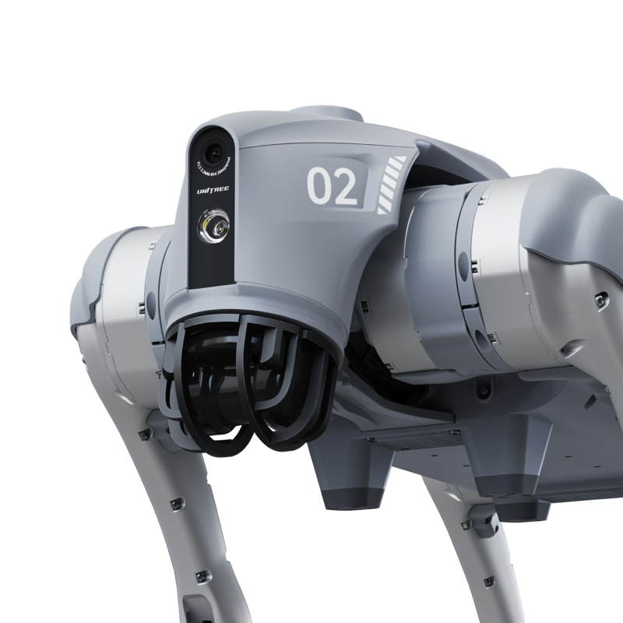
Meet Ben-Ben!
Source: https://shop.unitree.com/en-de/products/unitree-go2
Unitree Go2
12 aluminum alloy precision joint motors
Controlled gait-walking
Can perform interactive poses
Payload of 7 kilos
Application or Remote-controlled(R3)

Slide 5
Meet Ben!
Unitree Go2
12 aluminum alloy precision joint motors
Controlled gait-walking
Can perform interactive poses
Payload of 7 kilos
Application or Remote-controlled(R3)
Source: https://shop.unitree.com/en-de/products/unitree-go2

Slide 6
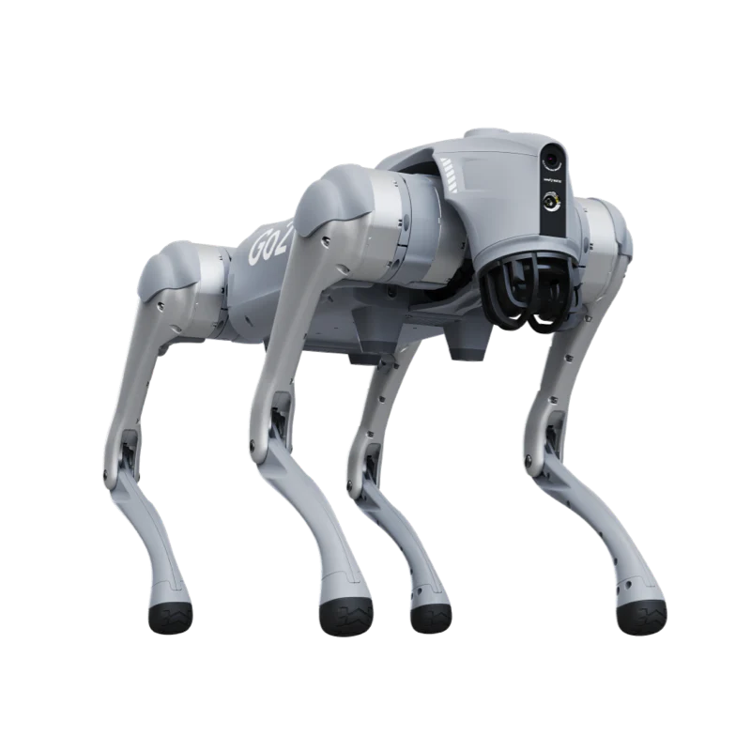
Building the Brain
Source: https://shop.unitree.com/en-de/products/unitree-go2
Using a variety of sensors, processing all the data gathered, via a centralized microcontroller.
Path-finding algorithm to navigate around the pre-determined environment.
Autonomous navigation to a desired destination avoiding obstacles.

Slide 7

Building the Brain
Using a variety of sensors, processing all the data gathered, via a centralized microcontroller.
Path-finding algorithm to navigate around the pre-determined environment.
Autonomous navigation to a desired destination avoiding obstacles.
Source: https://shop.unitree.com/en-de/products/unitree-go2

Slide 8
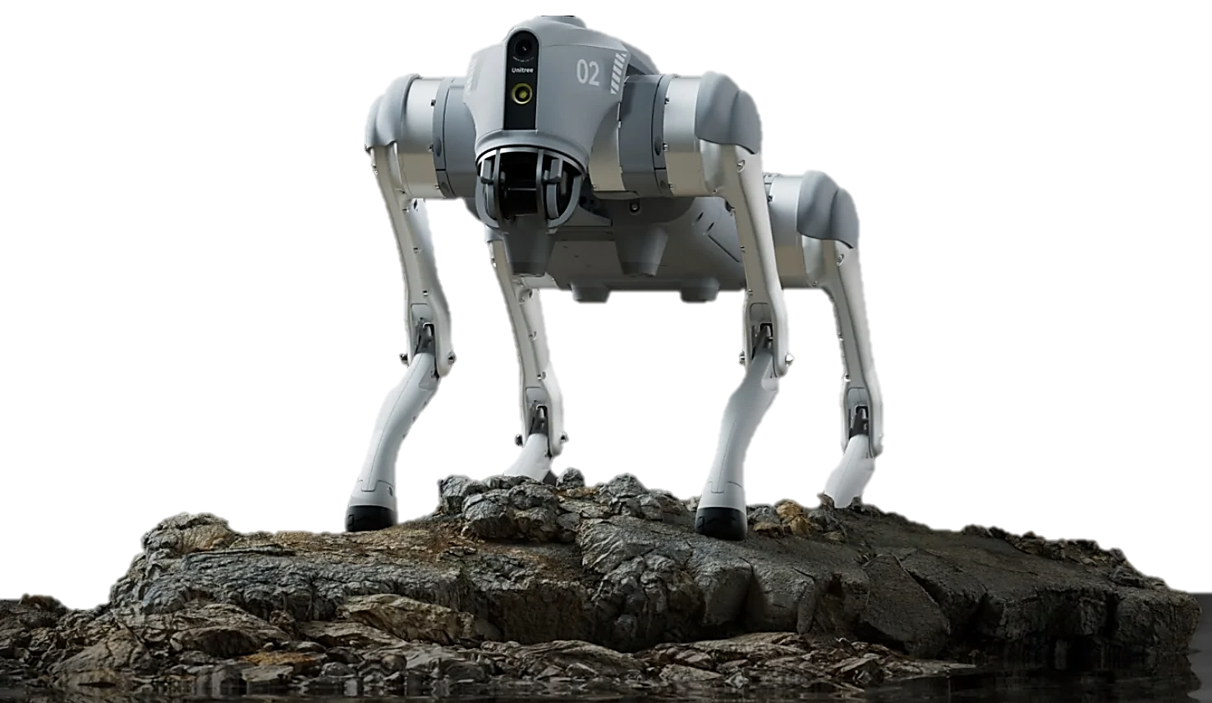
MOTIVATION
Source: https://shop.unitree.com/en-de/products/unitree-go2
Theory to Practical application
Understanding sensor fusion
‘Cause it’s fun!
Future Scope:
Package delivery
Campus Patrol

Slide 9

MOTIVATION
Theory to Practical application
Understanding sensor fusion
‘Cause it’s fun!
Future Scope:
Package delivery
Campus Patrol
Source: https://shop.unitree.com/en-de/products/unitree-go2

Slide 10
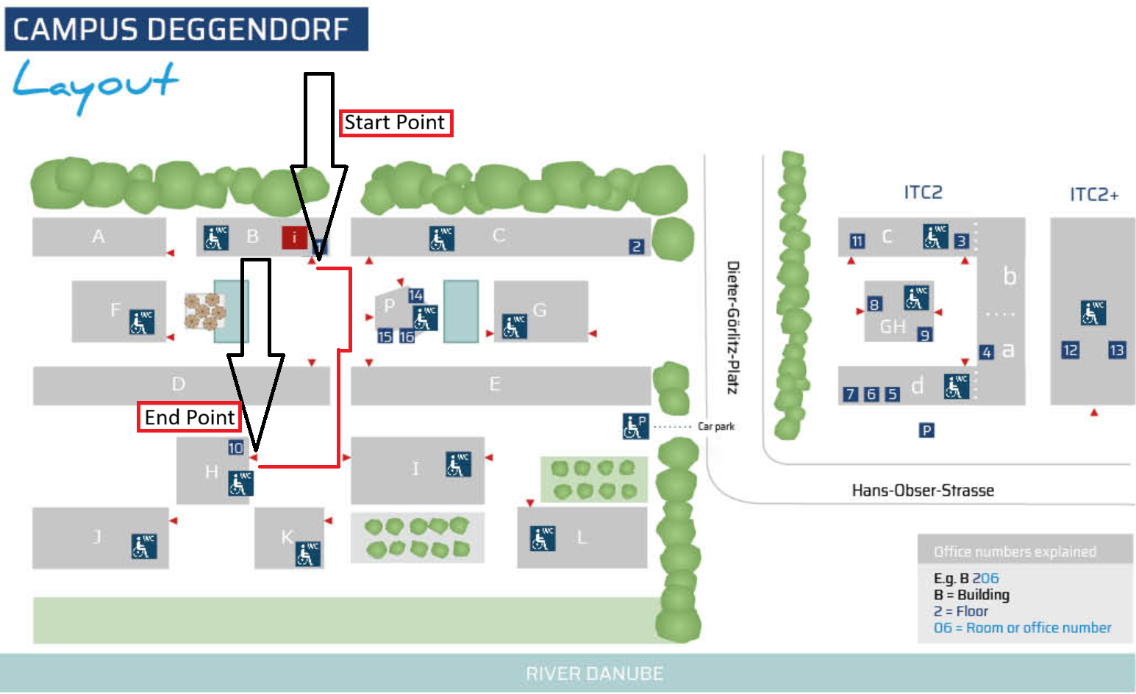
EXPECTED OUTCOMES

Slide 11
EXPECTED OUTCOMES
Source: https://www.th-deg.de

Slide 12
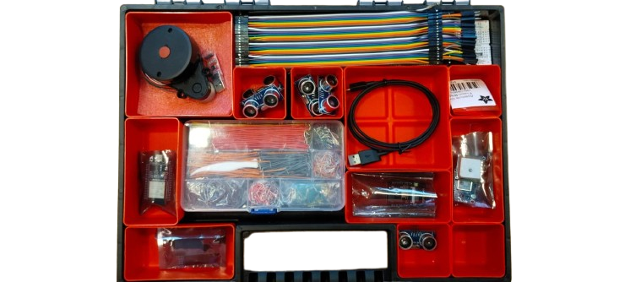
SENSORS

Slide 13
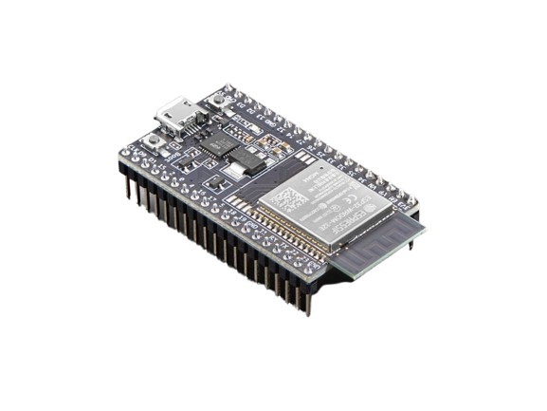
ESP32 DEV Board
Source: https://cdn-shop.adafruit.com/970x728/3269-04.jpg
32-bit dual-core microcontroller
Compatible with Arduino IDE
Wireless functionality (WiFi and BlueTooth)
Wide range of peripherals including:
  GPIO
  12-bit ADCs
  8-bit DACs
  SPI
  I²C
  UART
  I²S
Operates at 3.3V with ultra-low-power deep sleep modes

Slide 14
ESP32 DEV Board
32-bit dual-core microcontroller
Compatible with Arduino IDE
Wireless functionality (WiFi and BlueTooth)
Wide range of peripherals including:
  GPIO
  12-bit ADCs
  8-bit DACs
  SPI
  I²C
  UART
  I²S
Operates at 3.3V with ultra-low-power deep sleep modes
Source: https://cdn-shop.adafruit.com/970x728/3269-04.jpg

Slide 15
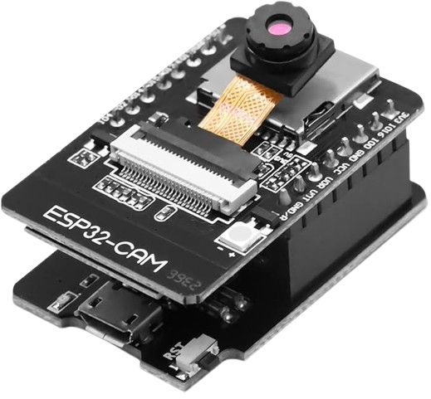
ESP32 CAM module
Source: https://cdn-shop.adafruit.com/970x728/3269-04.jpg
Standalone device
Wireless functionality (WiFi and BlueTooth)
Camera sensor: OV2640
  Resolution: 2MP (1600 x 1200)
Wide range of peripherals including:
  GPIO
  SPI
  I²C
  UART
  PWM

Slide 16
ESP32 CAM module
Standalone device
Wireless functionality (WiFi and BlueTooth)
Camera sensor: OV2640
  Resolution: 2MP (1600 x 1200)
Wide range of peripherals including:
  GPIO
  SPI
  I²C
  UART
  PWM
Source: https://cdn-shop.adafruit.com/970x728/3269-04.jpg

Slide 17
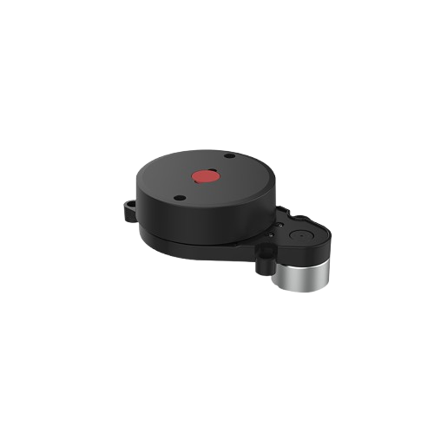
LiDAR
(Light Detection and Ranging)
Source: https://rootsrumshack.com/cgi-sys/suspendedpage.cgi
Range: 0.1 – 8 m
360° Horizontal Field of View
-0.5 ° to 0.5 ° Vertical Field of View
Ranging principle: Triangulation

Slide 18
LiDAR (Light Detection and Ranging)
Range: 0.1 – 8 m
360° Horizontal Field of View
-0.5 ° to 0.5 ° Vertical Field of View
Ranging principle: Triangulation
Source: https://rootsrumshack.com/cgi-sys/suspendedpage.cgi

Slide 19
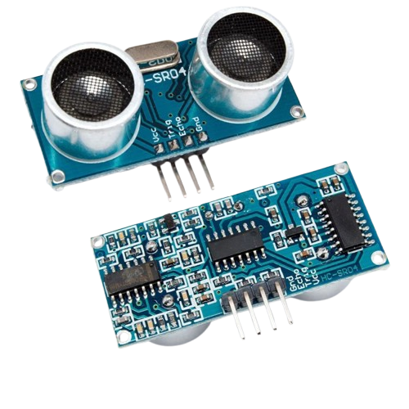
Ultrasonic sensor
Source: https://www.canadarobotix.com/products/1072
Sensing principle: SoNAR (Sound Navigation and Ranging)
Range: 2cm to 60cm

Slide 20
Ultrasonic sensor
Sensing principle: SoNAR (Sound Navigation and Ranging)
Range: 2cm to 60cm
Source: https://www.canadarobotix.com/products/1072

Slide 21
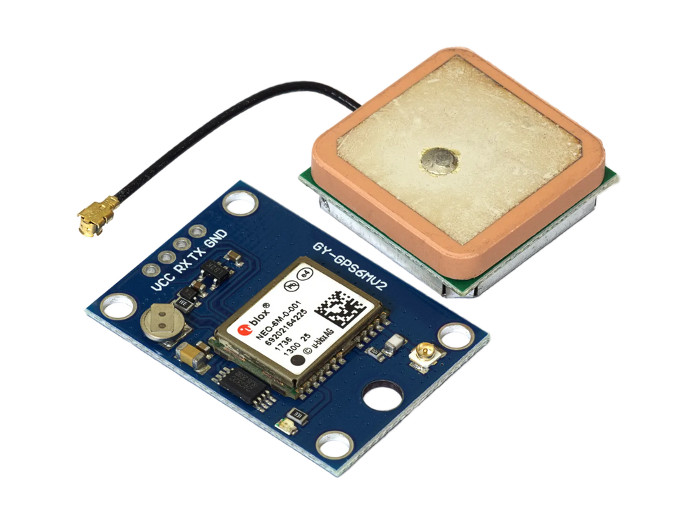
GPS
Source: https://arduino-projekte.info/cdn/shop/files/GY-NEO6MV2-GSP-Side-2.webp
Satellite based navigation system
Operating principle: Trilateration
Accurate to 2-2.5m in open-sky conditions

Slide 22
GPS
Satellite based navigation system
Operating principle: Trilateration
Accurate to 2-2.5m in open-sky conditions
Source: https://arduino-projekte.info/cdn/shop/files/GY-NEO6MV2-GSP-Side-2.webp

Slide 23
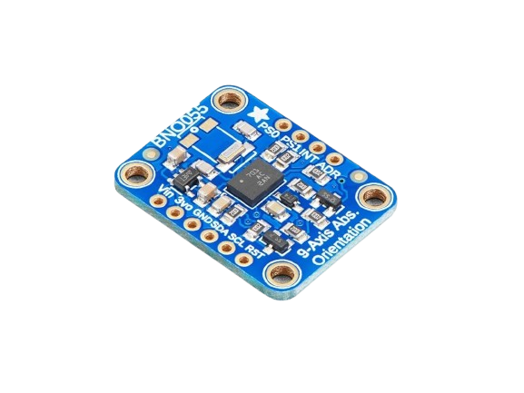
IMU
(Intertial Measurement Unit)
Source: https://m.media-amazon.com/images/I/51qEXrfKgTL._SX522_.jpg
9 DOF system-in-package
  3-axis Accelerometer
  3-axis Gyroscope
  3-axis Magnetometer
Processor: 32-bit ARM Cortex

Slide 24
IMU (Intertial Measurement Unit)
9 DOF system-in-package
  3-axis Accelerometer
  3-axis Gyroscope
  3-axis Magnetometer
Processor: 32-bit ARM Cortex
Source: https://m.media-amazon.com/images/I/51qEXrfKgTL._SX522_.jpg

Slide 25
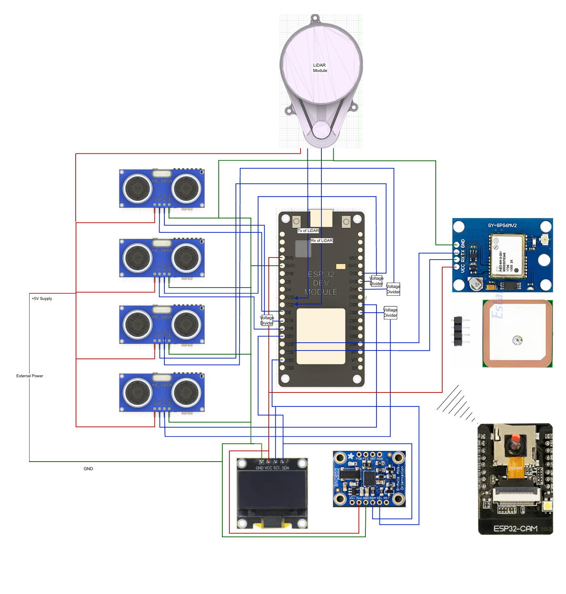
WIRING SCHEME

Slide 26
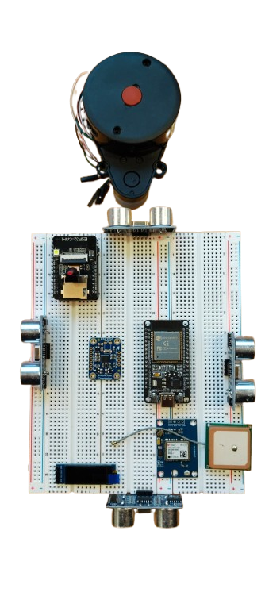

Slide 28
CONCLUSION
The relevant datasheets of all the sensors and wiring scheme will be uploaded in the CAS ilearn Platform.

Slide 29
Any Questions?
nitin.medisetti@stud.th-deg.de
saikumar.konakanchi@stud.th-deg.de

